Slide 1
Master in Applied &
Computational Mathematics
BNumMet
A Scholar implementation of Numerical Methods in Python enhanced with interactive widgets
Author: Fernando Bellido Pazos
Tutor: Juan Manuel Perez Pardo
End of Master’s Thesis: Defense

Slide 2
Contents
Introduction
State of the art
Previous Work
Objectives
Software Development
Software Description
Linear Systems
Interpolation
Non-Linear Equation Solver
Least Squares
Random Number Generator
Ending Remarks

Slide 3
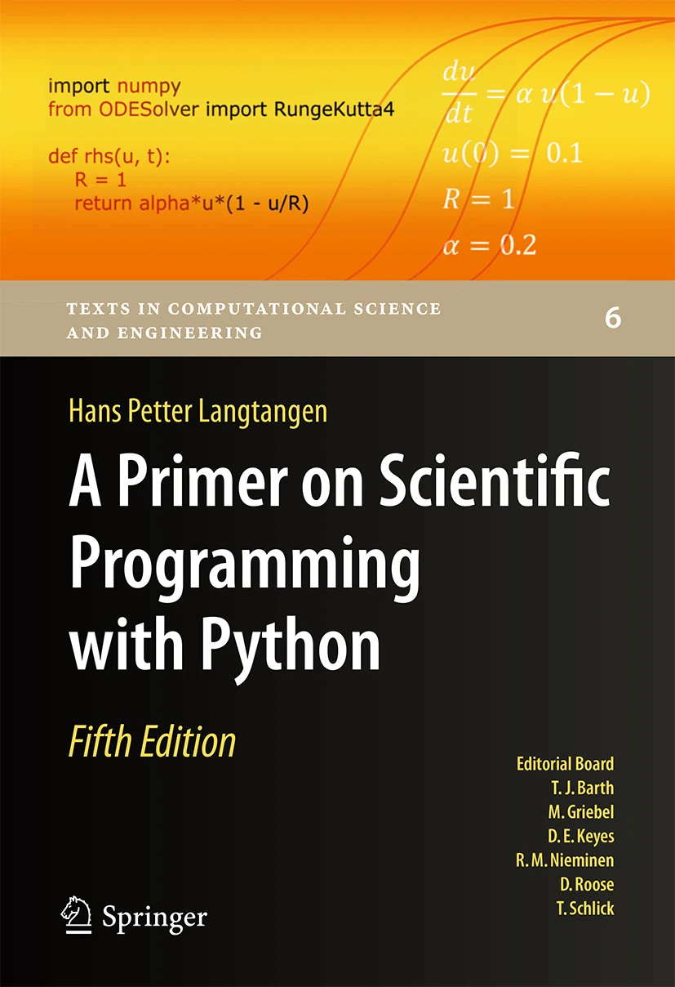
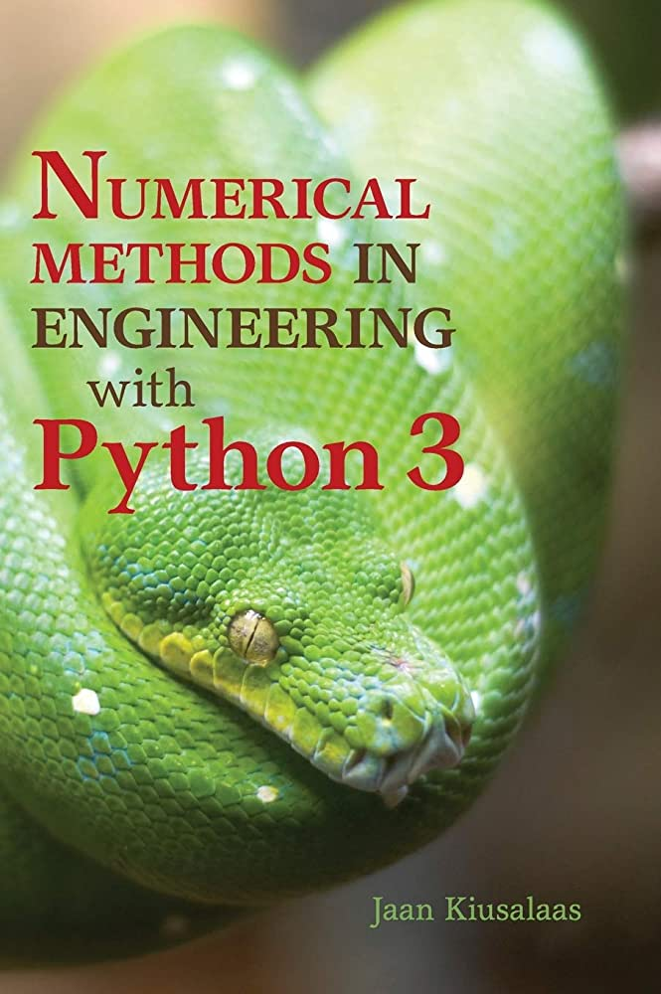
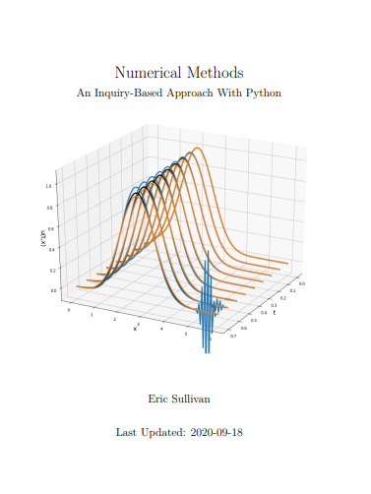
State of the Art

Slide 4
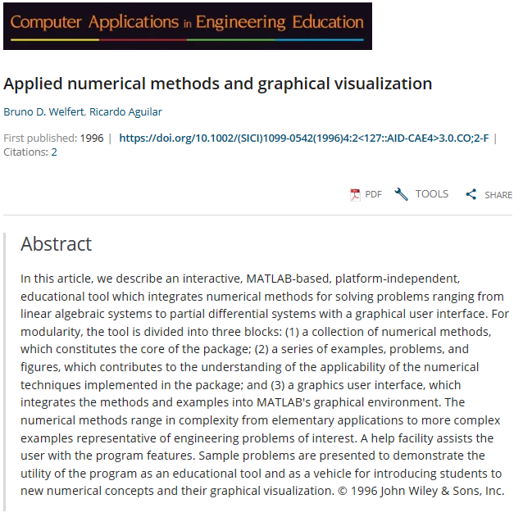
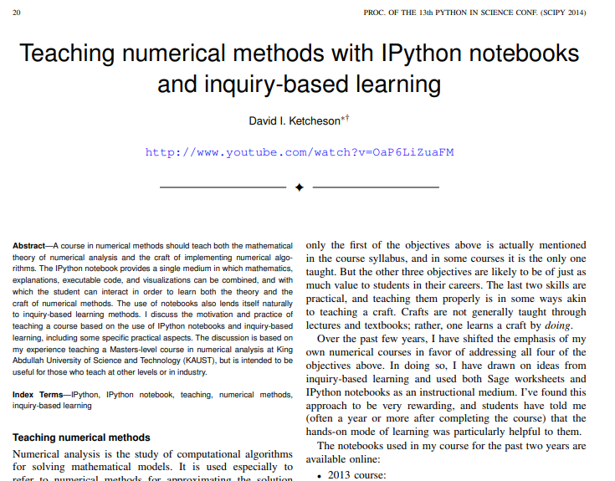
State of the Art

Slide 5

Previous Work
Numerical Computing With MATLAB – Cleve B.Moler
Programming Language: MATLAB
11 Chapters : Code & Visualization
Private Licensed
Graphical User Interface: Not Intuitive and user-friendly
MATLAB’s Home License: 119€

Slide 6
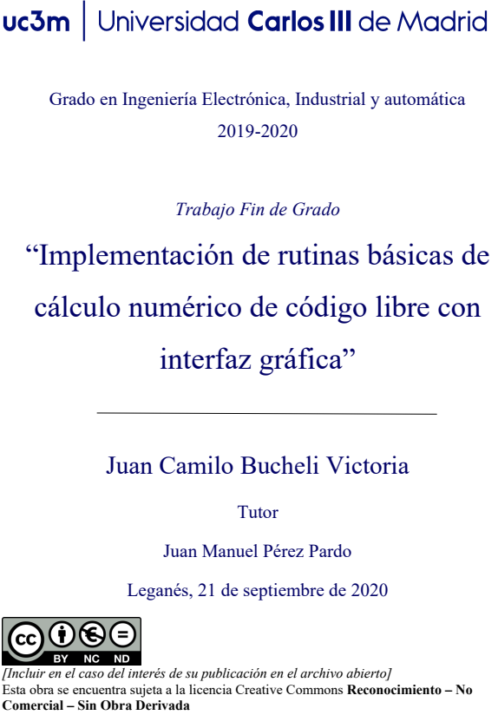
Previous Work
End of Degree’s Thesis – Juan Camilo Bucheli
Programming Language: Python
2 Packages: Linear Systems & Interpolation
Open Source Licensed (Apache 2.0)
Graphical User Interface: NOT functional to this day
Language: Spanish

Slide 7
Objectives
Scholar Numerical Method
Graphical User Interface
BNumMet
Students

Slide 8
Objectives
General Code
Open Source
English
G.U.I.
Provide Insight on algorithm
Modular on Input
PC-Human Interaction theory
Efficiency
Self-Contained
Easy to use
Interact and observe changes Dynamically
Easy to Read
Functional

Slide 9
Software Development
Initiation
Roles
Life Cycle Model: Iterative Life Cycle
Planning
Schedule Frame: October 2022 - 15 June in 2 Week Iterations
Execution
Quality Assurance: Unit Test & SonarQube
Software Configuration Management: Github & vX.Y.Z Scheme
Ending
Packaging: PIP & Public Github
Development Framework: Python $≥3.8$ & Jupyter
Development Framework: Python ≥3.8 & Jupyter
Licensing: GNU Affero General Public Licence v3.0
Future Development

Slide 10
Software Description

Slide 11
Code written from 0
BNumMet
Analysis of solutions
Readable

Slide 12
Linear Systems
Packages
LU Decomposition*
Forward & Backward Substitution
LU Solver
QR Decomposition
QR Solver

Slide 13
Linear Systems
Discussion: LU Decomposition
[C|B] – 1/X·[C] [X|A]
X
A
B
C
B
X
A
C
– 1/X ·
C

Slide 14
Linear Systems
Discussion: LU Decomposition
[C|B] – 1/X·[C] [X|A]
X
A
B
B
C
X
A
C
– 1/X ·
C

Slide 15
Linear Systems
Discussion: LU Decomposition
Submatrices Syntax
New-Axis Syntax
Outer Product
For Loop
A[col + 1 :, :][:, [col]] @ A[[col], :][:, col + 1 :]
A[col, col + 1 :][np.newaxis, :]
np.outer(A[col + 1 :, col], A[col, col + 1 :])
for row in range(col + 1, n)
B
C
X
A
C
– 1/X ·

Slide 16
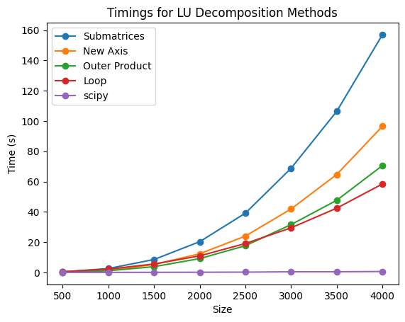
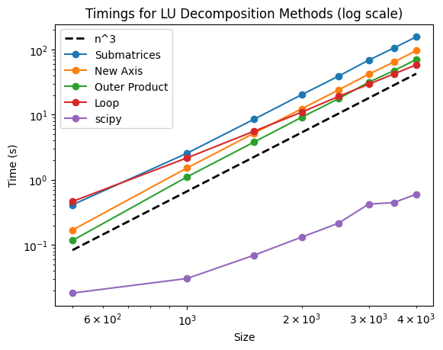
Linear Systems
Discussion: LU Decomposition
 | Slope
■ Submatrices | 2.8852
■ New Axis | 3.0434
■ Outer Product | 3.0717
■ Loop | 2.334
■ Scipy | 1.8136

Slide 17
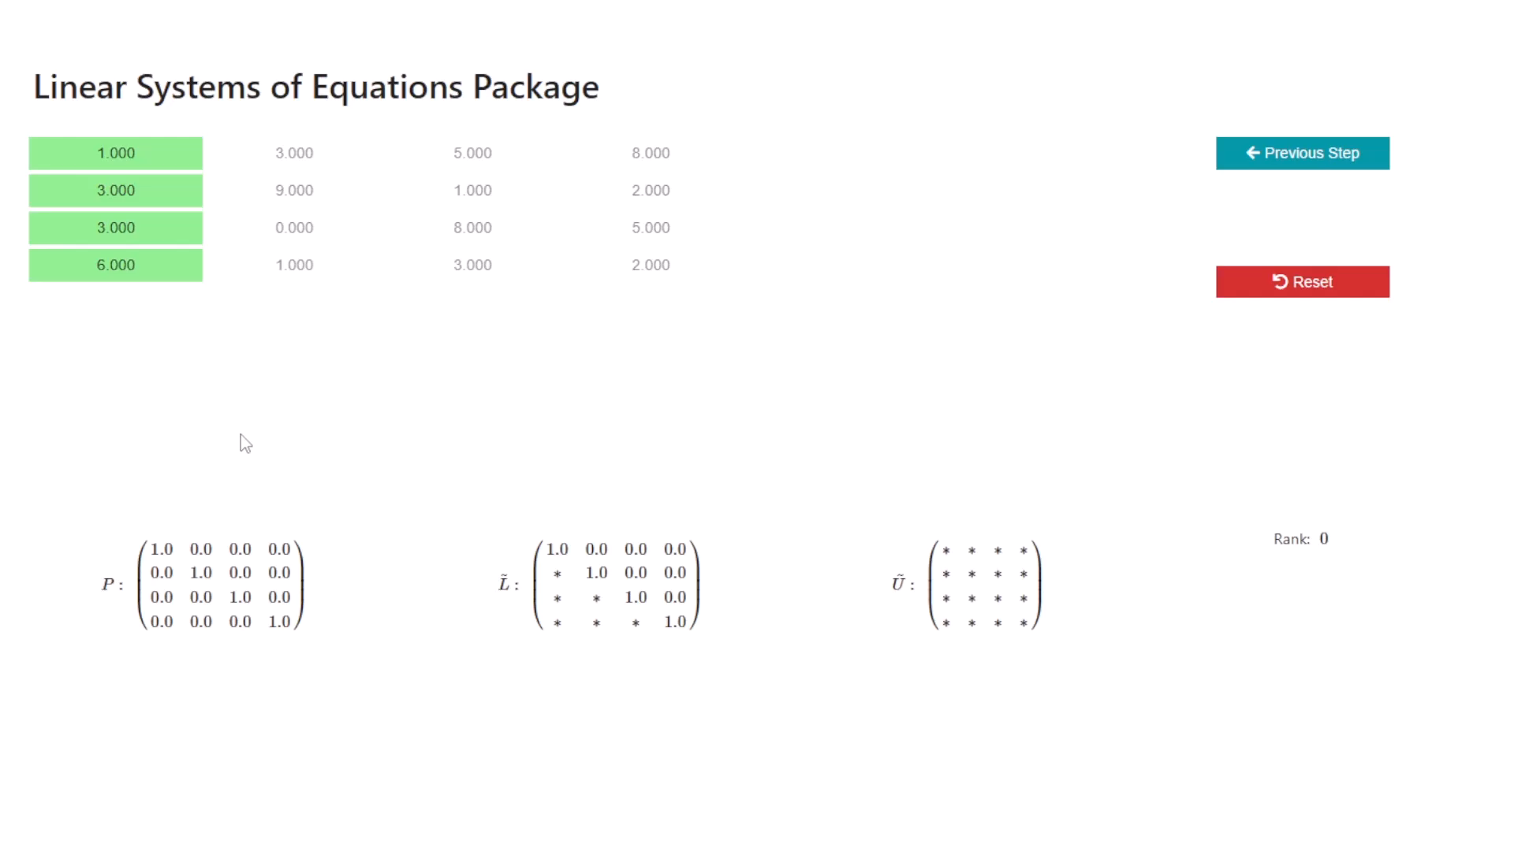
Linear Systems
Visualizer BNumMet

Slide 18
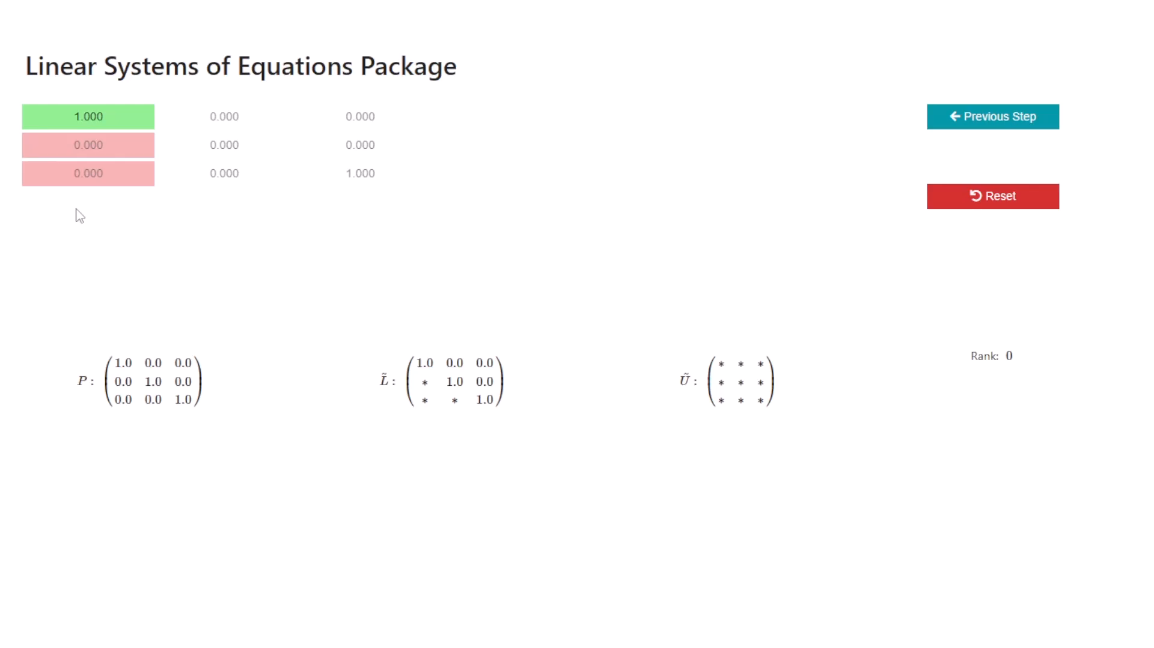
Linear Systems
Visualizer BNumMet

Slide 19
Interpolation
Packages
Polynomial Interpolation
Piecewise Linear Interpolation
Piecewise Cubic Hermite Interpolation
Piecewise Cubic Interpolation

Slide 20
Interpolation
Compute Slopes
Find indices of the points
Evaluate every interpolated point
Discussion: Interpolation
1. Compute the slopes of the lines
2. Find the indices of the data points just smaller than the corresponding u values
3. Calculate the interpolated y values based on the slope of the line

Slide 21
Interpolation
Discussion: Interpolation
List Comprehension
v = [ y[k[i] - 1] + s[i] * (d[k[i] - 1] + s[i] * (c[k[i] - 1] + s[i] * b[k[i] - 1]))
for i in range(len(u)) ]
Evaluate every interpolated point
Fancy Indexing
v = y[k] + s * (d[k] + s * (c[k] + s * b[k]))

Slide 22
Interpolation
Discussion: Interpolation
List Comprehension
v = [ y[k[i] - 1] + s[i] * (d[k[i] - 1] + s[i] * (c[k[i] - 1] + s[i] * b[k[i] - 1]))
for i in range(len(u)) ]
Evaluate every interpolated point
Fancy Indexing
v = y[k] + s * (d[k] + s * (c[k] + s * b[k]))

Slide 23
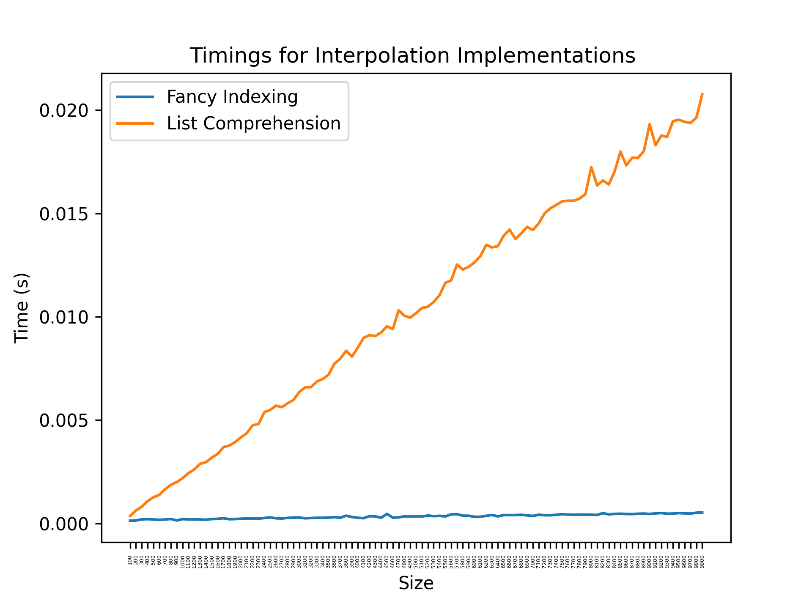
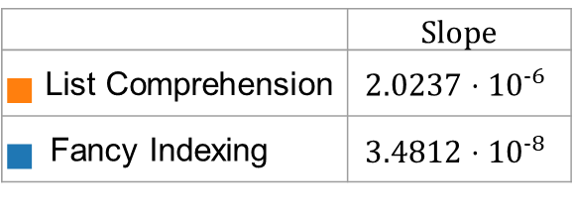
Interpolation
Discussion: Interpolation
 | Slope
■ List Comprehension | $$2.0237⋅{10}^{−6}$$
■ Fancy Indexing | $$3.4812⋅{10}^{−8}$$

Slide 24
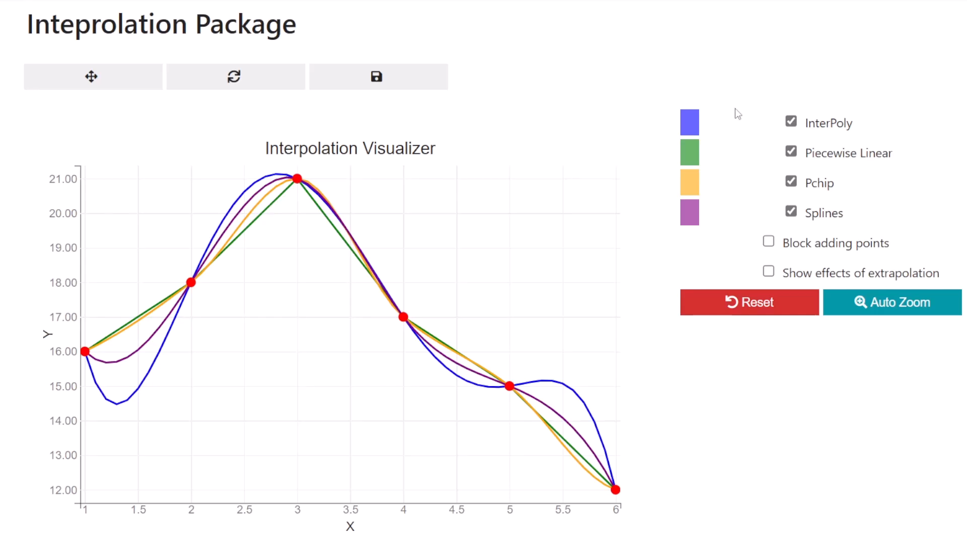
Interpolation
Visualizer BNumMet

Slide 25
Non-Linear Equation Solver
Packages
Bisection
Newton’s Method
Secant Method
Inverse Quadratic Interpolation
Brent-Dekker’s Method

Slide 26
Non-Linear Equation Solver
Discussion
Original
Brent-Dekker
MATLAB’s
Brent-Dekker
Scipy’s Brent-Dekker
Vs.
Vs.

Slide 27
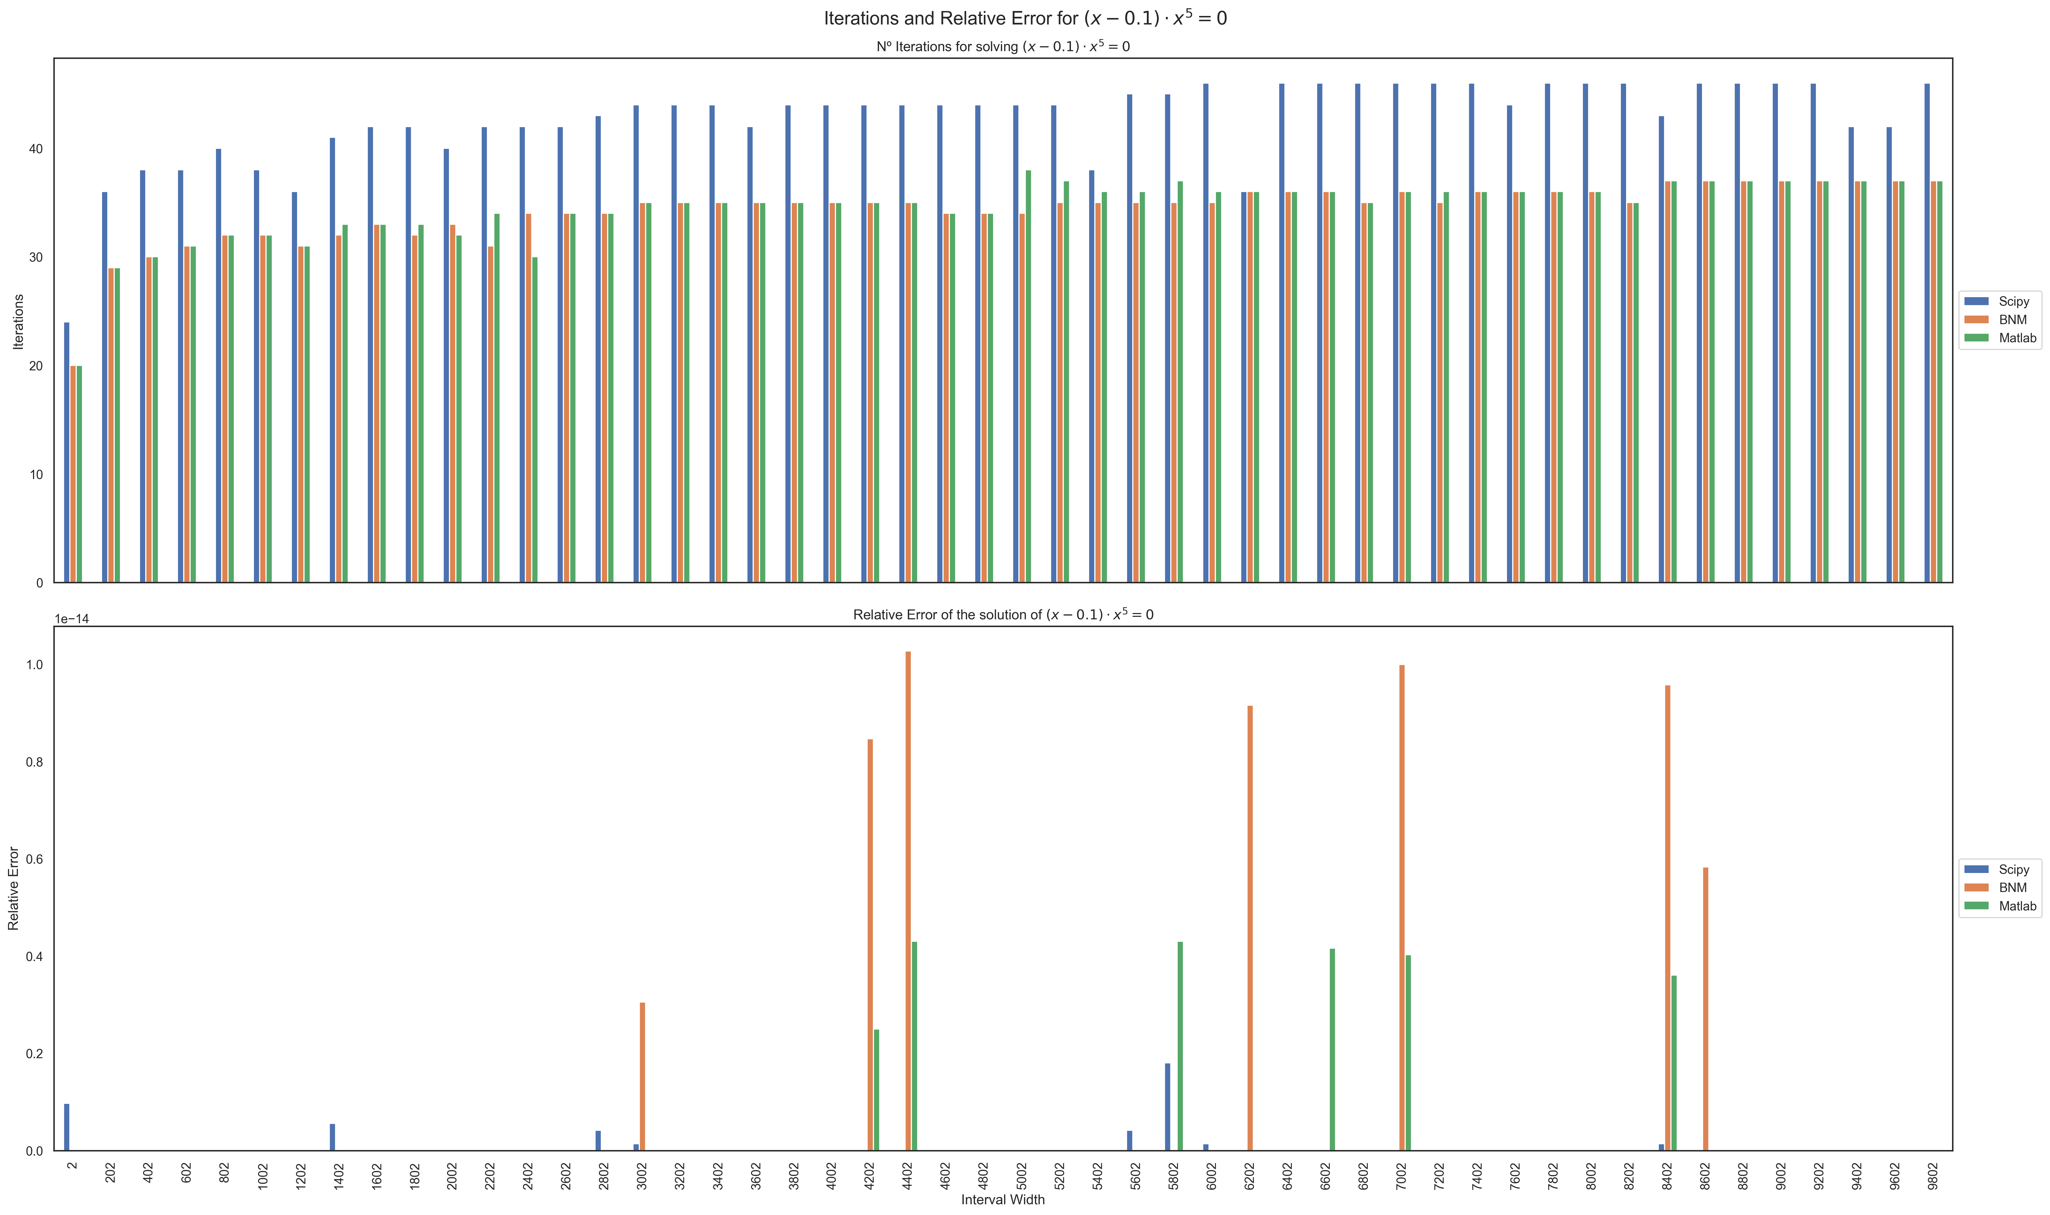

Slide 28
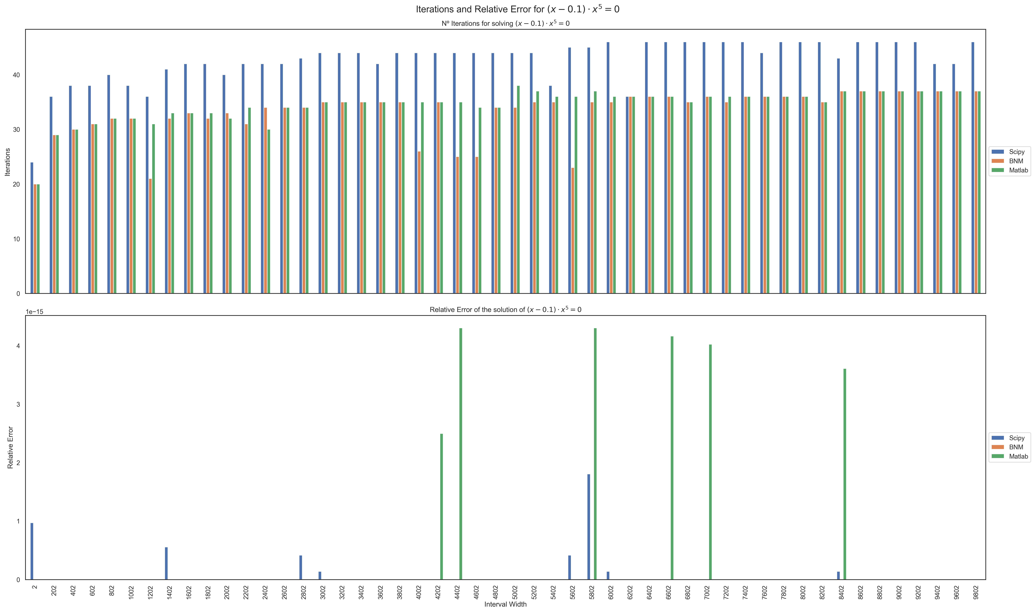

Slide 29
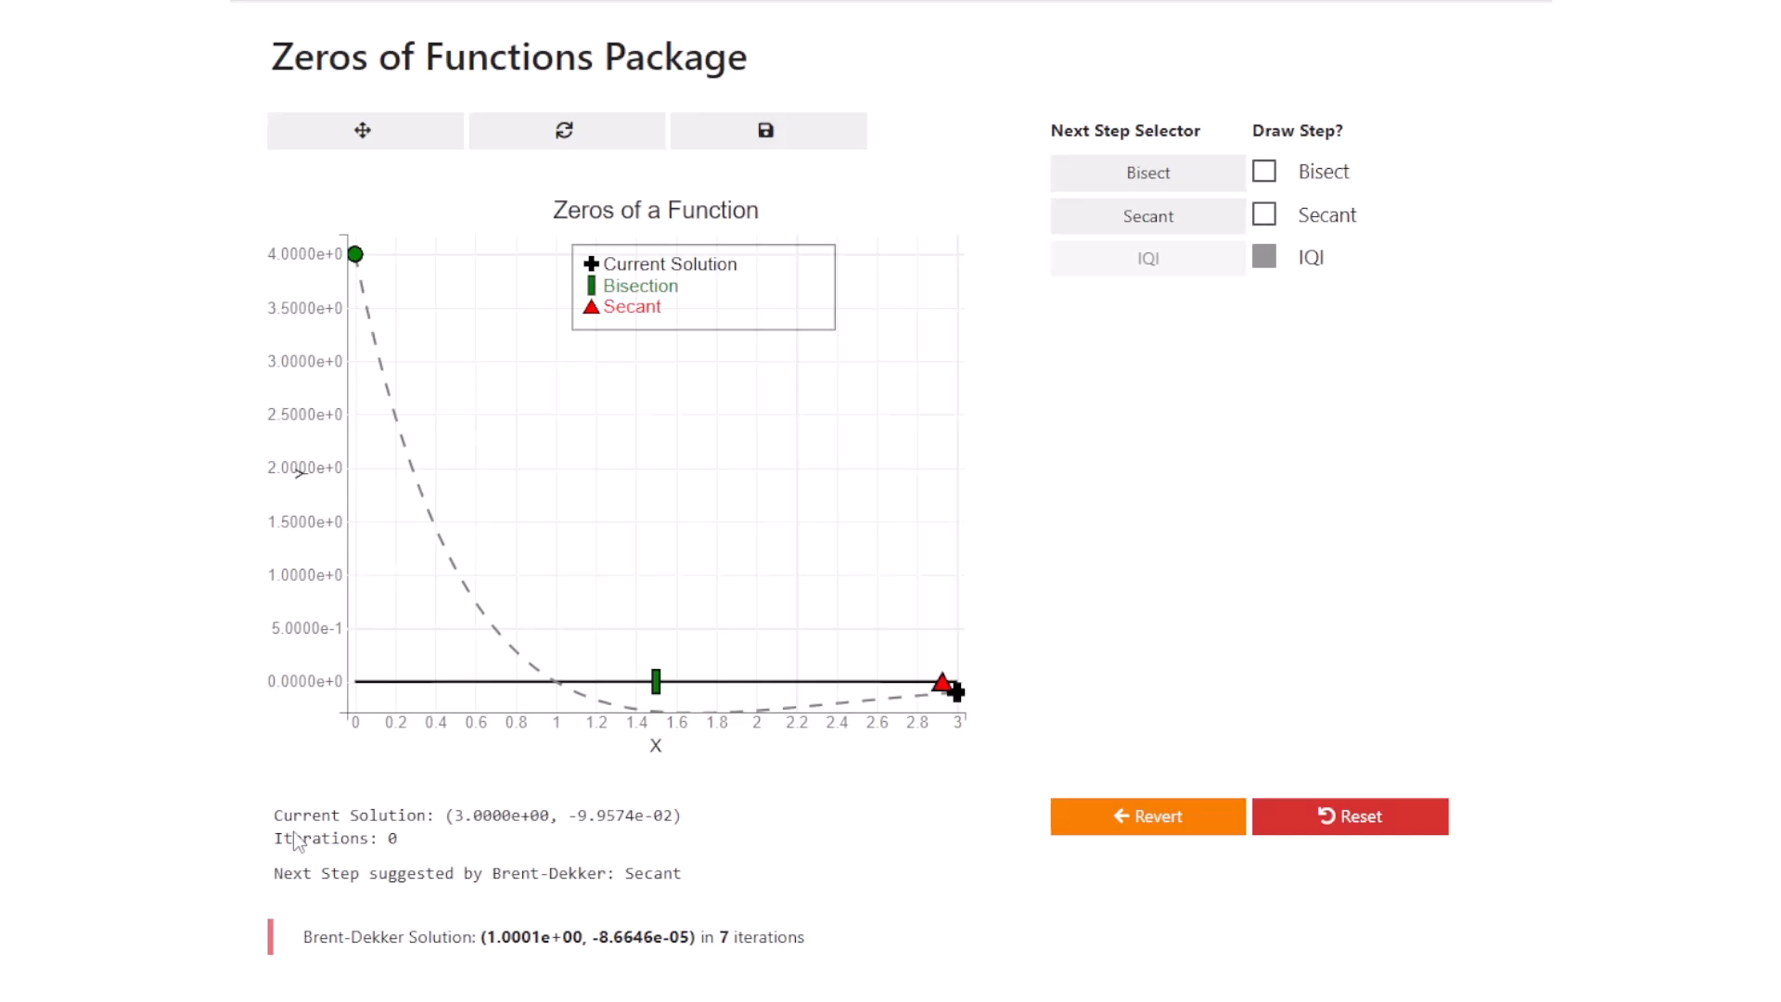
Non Linear Equation Solver
Visualizer BNumMet

Slide 30
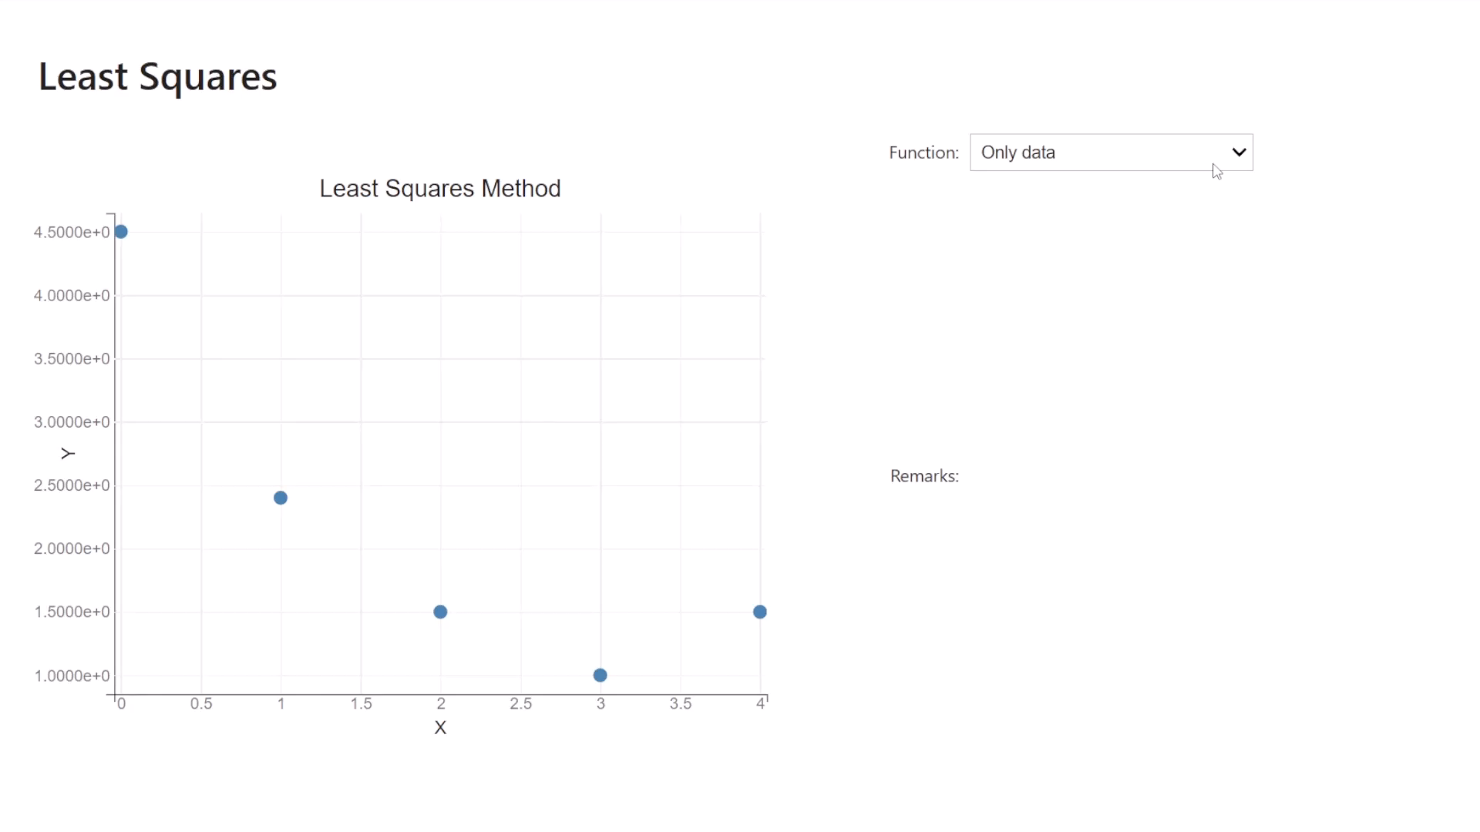
Least Squares
Visualizer BNumMet

Slide 31
Random Number Generators
Packages
Lehmer’s
Linear Congruential Algorithm
$$x_{n+1}=\left(a⋅x_{n}+c\right) mod\left(n\right)$$
𝑥_(𝑛+1)=(𝑎⋅𝑥_𝑛+𝑐) 𝑚𝑜𝑑(𝑛)
Marsaglia’s
Subtract With Borrow or Add with Borrow
$$f\left(x_{1},x_{2},…,x_{r},c\right)=\left\{\begin{aligned}\begin{matrix}(x_{2},…,x_{r},x_{r+1−s}−x_{1}−c,0) & x_{r+1−s}−x_{1}−c≥0\end{matrix} \\ \begin{matrix}(x_{2},{…,x_{r},x}_{r+1−s}−x_{2}−c+b,1) & x_{r+1−s}−x_{1}−c<0\end{matrix}\end{aligned}\right.$$
𝑓(𝑥_1,𝑥_2,…,𝑥_𝑟,𝑐)={█(■8((𝑥_2,…,𝑥_𝑟,𝑥_(𝑟+1−𝑠)−𝑥_1−𝑐,0)&𝑥_(𝑟+1−𝑠)−𝑥_1−𝑐≥0)@■8((𝑥_2,〖…,𝑥_𝑟,𝑥〗_(𝑟+1−𝑠)−𝑥_2−𝑐+𝑏,1)&𝑥_(𝑟+1−𝑠)−𝑥_1−𝑐<0))┤
Mersenne-Twister
Up to date RNG
Used in Python & R

Slide 32
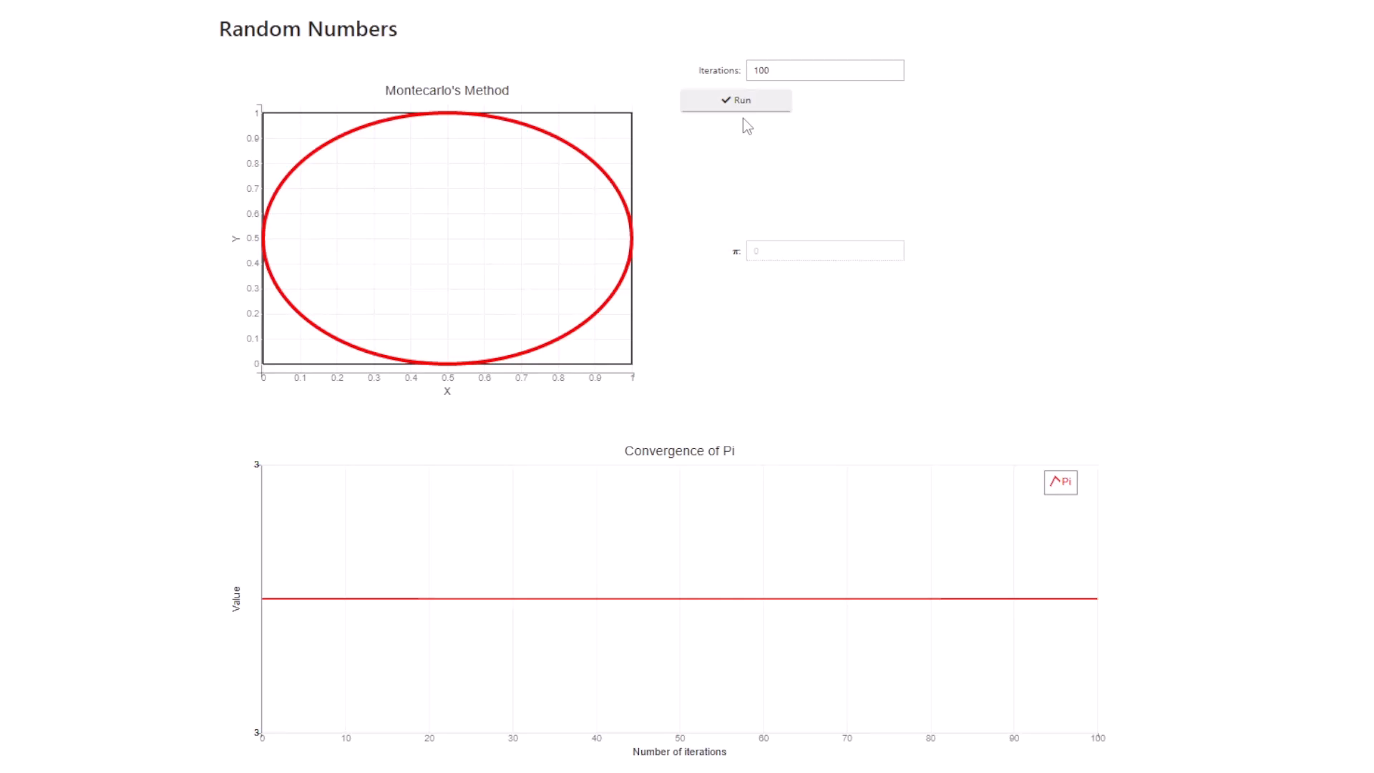
Random Number Generators
Visualizer BNumMet

Slide 33
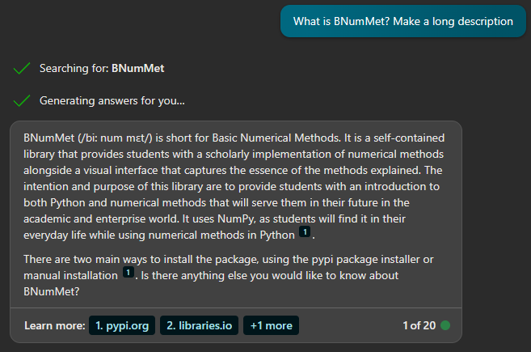

Ending

Slide 34
End of Master’s Thesis: Defense
Thank you for your attention
Any questions?
NAME
Fernando Bellido Pazos
MAIL
fbellidopazos@gmail.com
MASTER
Applied & Computational Mathematics
TUTOR
Juan Manuel Perez Pardo

Slide 35
Linear Systems
Discussion: LU Decomposition
Submatrices Syntax
Outer Product
A[col + 1 :, col] = A[col + 1 :, col] / pivot
A[col + 1 :, col + 1 :] = A[col + 1 :, col + 1 :] - (A[col + 1 :, :][:, [col]] @ A[[col], :][:, col + 1 :])
A[col + 1 :, col] = A[col + 1 :, col] / pivot
A[col + 1 :, col + 1 :] = np.outer(A[col + 1 :, col], A[col, col + 1 :])
New-Axis Syntax
For Loop
A[col + 1 :, col] = A[col + 1 :, col] / pivot
A[col + 1 :, col + 1 :] -= A[col + 1 :, col][:, np.newaxis] @ A[col, col + 1 :][np.newaxis, :]
for row in range(col + 1, n):
A[row, col] = A[row, col] / A[col, col]
A[row, col + 1 :] = A[row, col + 1 :] - A[row, col] * A[col, col + 1 :]

Slide 36
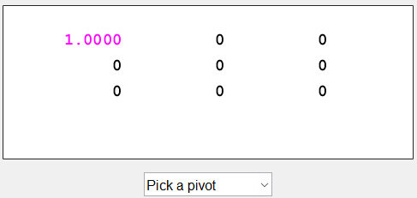
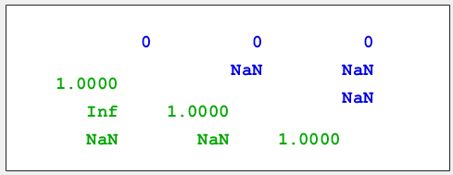
Linear Systems
Visualizer MATLAB

Slide 37
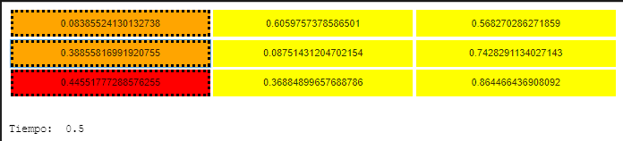
Linear Systems
Visualizer Camilo’s

Slide 38
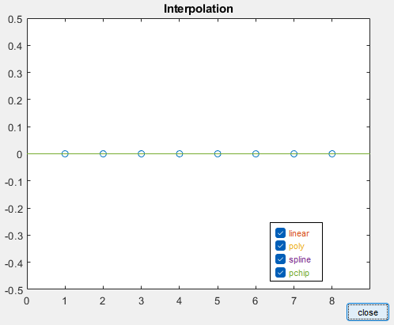
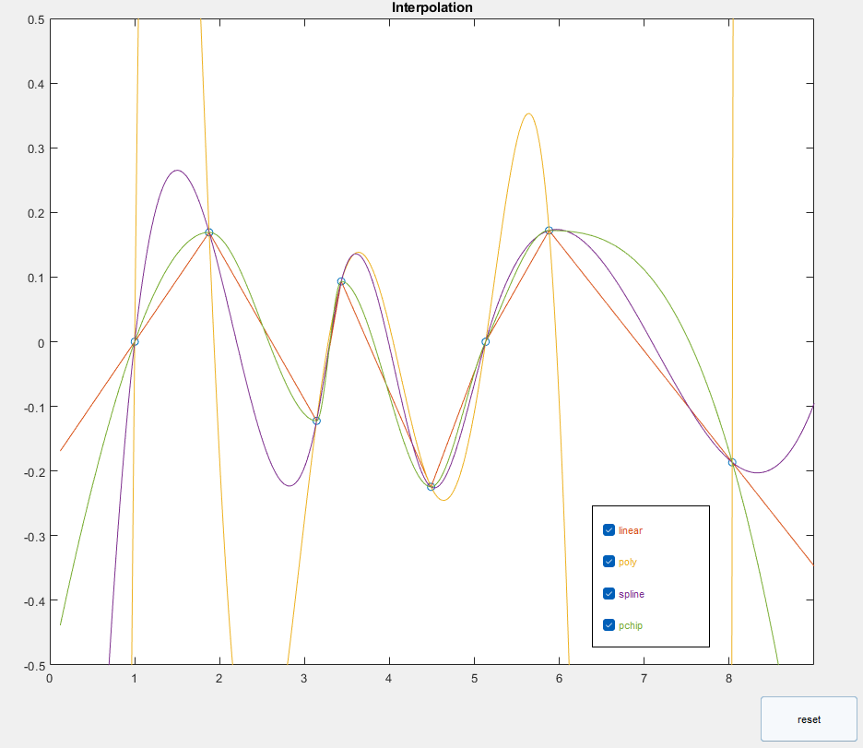
Interpolation
Visualizer MATLAB

Slide 39
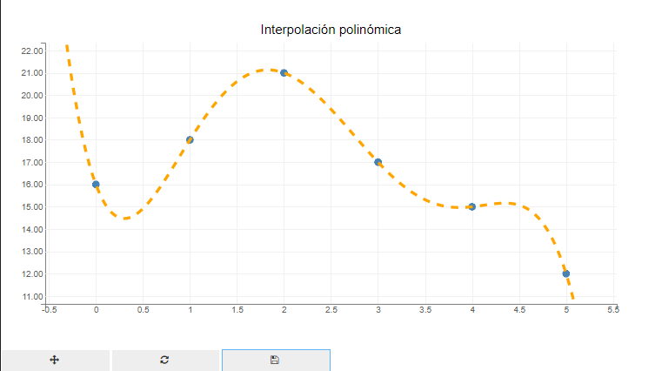
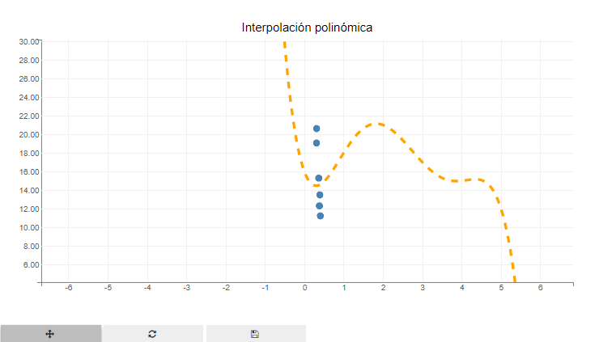
Interpolation
Visualizer Camilo’s

Slide 40
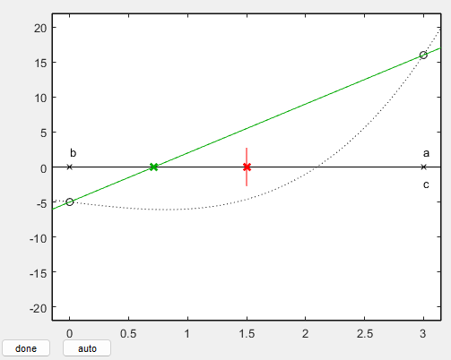
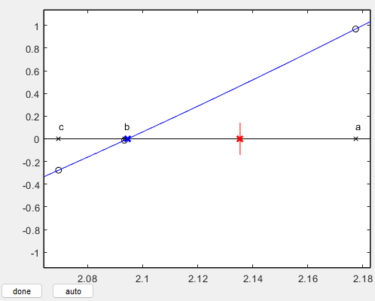
Non Linear Equation Solver
Visualizer MATLAB

Slide 41
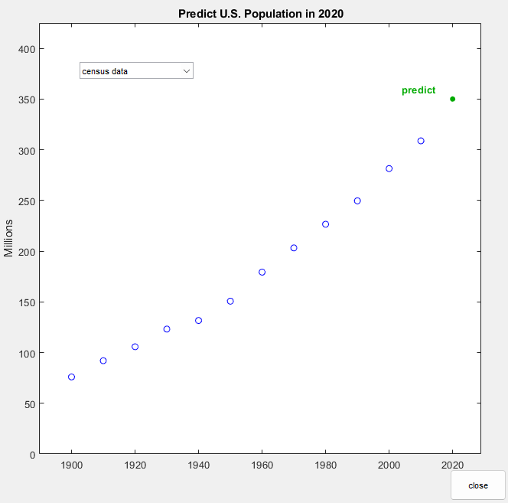
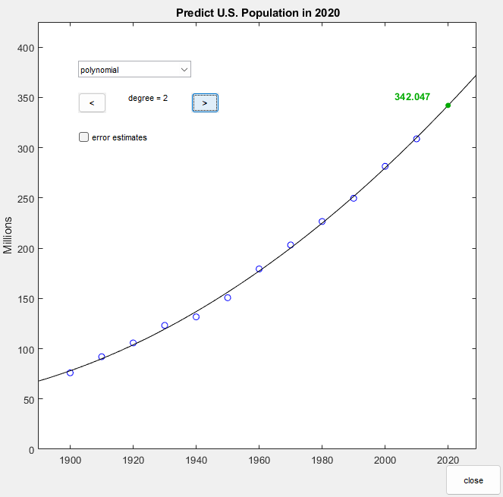
Least Squares
Visualizer MATLAB

Slide 42
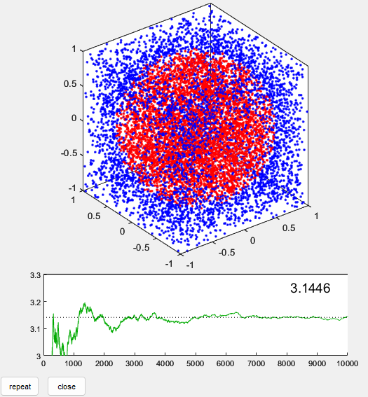
Random Number Generators
Visualizer: Montecarlo

